Slide 1
Telok Ayer Chinese Methodist Church From tin hut to national monument a pictorial walkthrough
CHURCH ARCHITECTURE OVERVIEW
Notes:
Ladies and Gentlemen, good afternoon. I am ________; and over the next 10 minutes, I will give you an overview of some interesting features of our church building, which will help you appreciate the history and heritage of our Church.
After the presentation, please feel free to walk around to see these features for yourselves. There will be guides around to provide more information and answer your questions, if you have any.

Slide 2
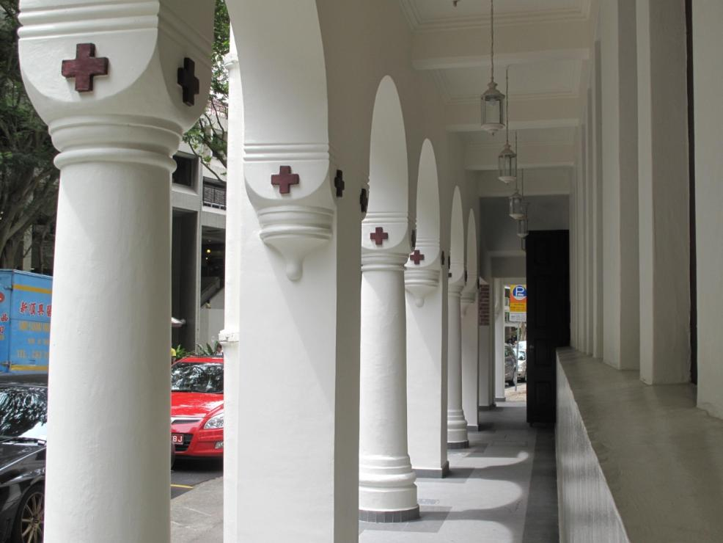
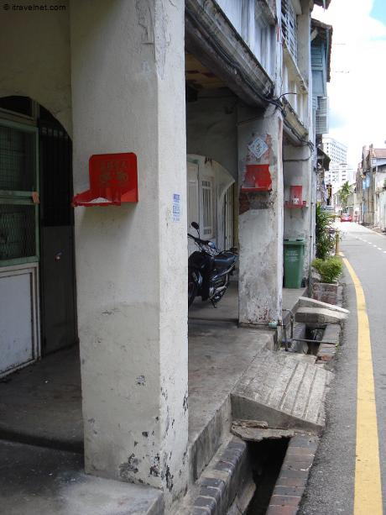
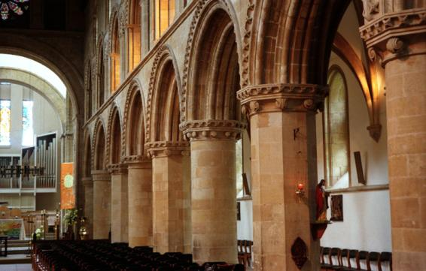
Typical shrines on columns along five-foot ways
Five-foot way with system of cross-marked alternating columns and piers
Similar system of alternating columns and piers in a European church
Notes:
Let me first start with the five-foot way outside the church building, which you may have noticed as you alighted the bus and came into the building.
Five-foot ways are a unique feature of shop-houses in Malaysia and Singapore. Sir Stamford Raffles had stipulated that shop-houses must have a covered walkway of about five feet along its street-front to shelter pedestrians from the sun and rain. The Hokkiens began to call these walkways “gor ka ki”, which can be translated literally into “five-foot way”. Although not a shop-house, a five-foot way was also constructed along the west side of our church building so that the Church would link up with the other five-foot ways of the shop-houses along Telok Ayer Street.
What is unique about TACMC’s five-foot way is the cross-marked alternating columns and piers that run along its corridor. Different from the solely-columnar design of the other five-foot ways in Singapore, this architectural design is commonly found in medieval church buildings in Europe. In addition, while most columns on five-foot ways are marked by a little red shrine, the ones on TACMC are marked with red crosses instead. This walkway thus captures the fusion of local, Western and Christian cultures.

Slide 3
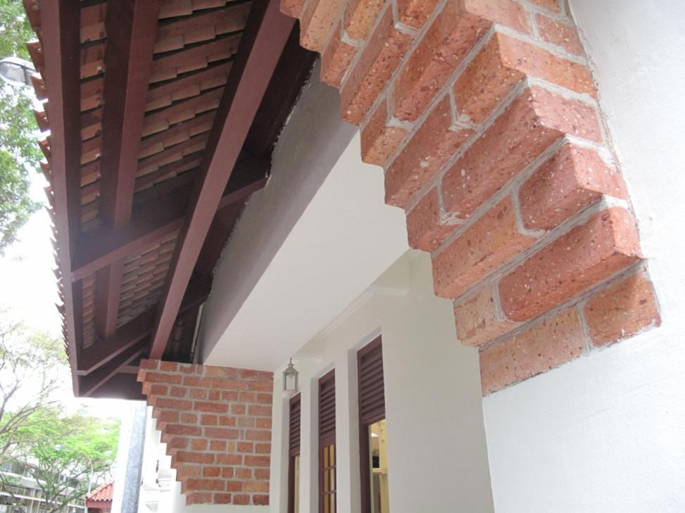
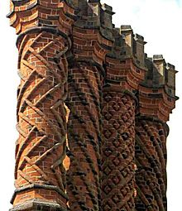
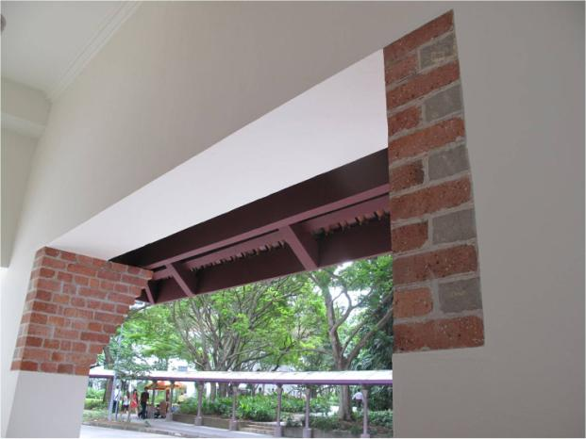
Decorative Tudor brick chimney at Hampton Court Palace (UK)
Fair-faced brickworks on the façade of Telok Ayer Chinese Methodist Church
Notes:
Along the five-foot way, you may also have noticed some “exposed” brickworks on the façade of the building. These brickworks were not exposed due to wear-and-tear, but were intentionally designed in this manner as part of the design. This is known as “fair-faced brickwork”, and reflects the care and skill invested into the church building when it was first erected. As the bricks were not plastered over, the brick masons had to take extra care to ensure that the placing of the bricks were neatly and beautifully executed. This form of architecture is common in many buildings in Europe, such as the Hampton Court Palace in the United Kingdom.

Slide 4
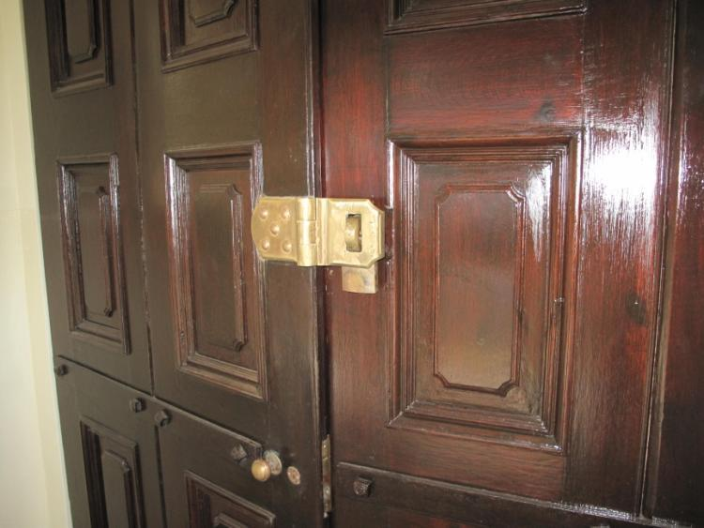
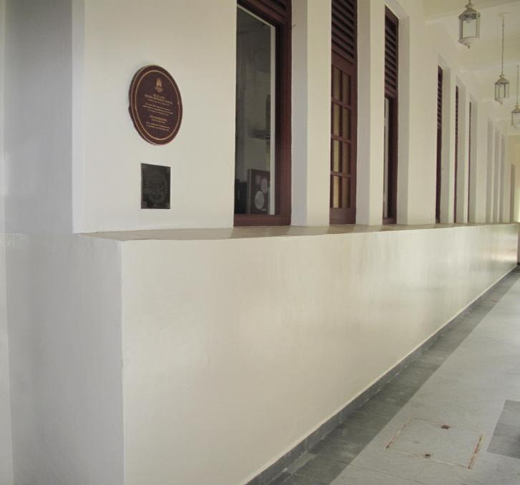
Front doors of the Church – originally built for a HSBC bank
Extended walls – a relic from World War II and a reminder of the role of the Church during the war
Notes:
If you look closely at the church wall along the five-foot way, you will notice that the wall underneath the windows has been extended from the original structure. As the Church served as a medical post and bomb shelter during World War II, the western wall of TACMC was extended to protect the refugees seeking sanctuary in the building from flying shrapnel. The wall extension remains up till this day, a reminder of the haven that God provided during those turbulent times.
Just beside the extended wall are the majestic front doors of the church building. The beautiful solid-wood doors, with a brass lockset from the 1920s, were originally built for a HSBC bank in the nearby business district, thus explaining its sturdy and imposing structure. For unrecorded reasons, the doors were brought over and installed in the church building instead, under the orders of the then-Colonial Secretary of Singapore in 1925.

Slide 5
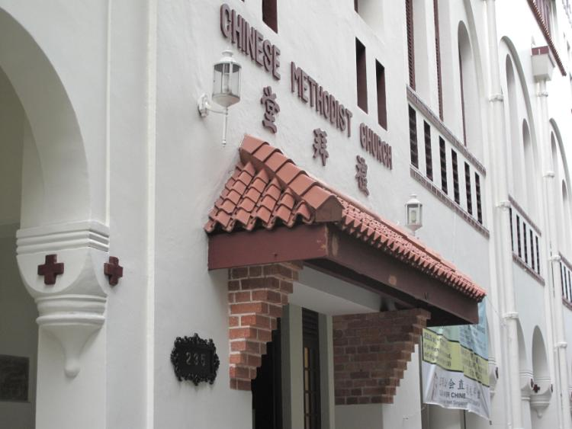
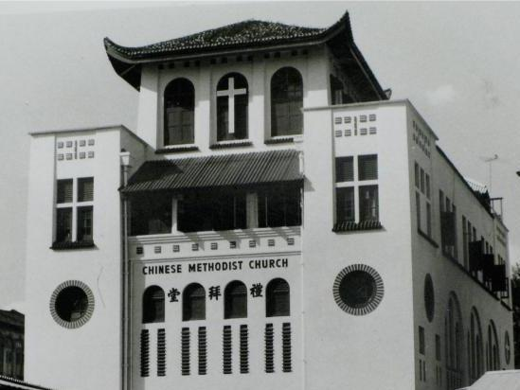
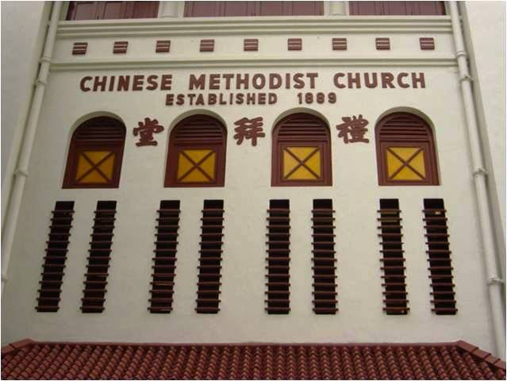
No need for “Telok Ayer”, just “Chinese Methodist Church” – because the Church was the only Chinese Methodist church in Singapore when the building was first completed in 1925
Notes:
You may also have noticed that the signs on the façade of the church building reads “Chinese Methodist Church” and not “Telok Ayer Chinese Methodist Church”. This reflects the fact that when the building was completed in 1925, she was the only Chinese Methodist church in Singapore (and possibly in the whole of Malaya).

Slide 6
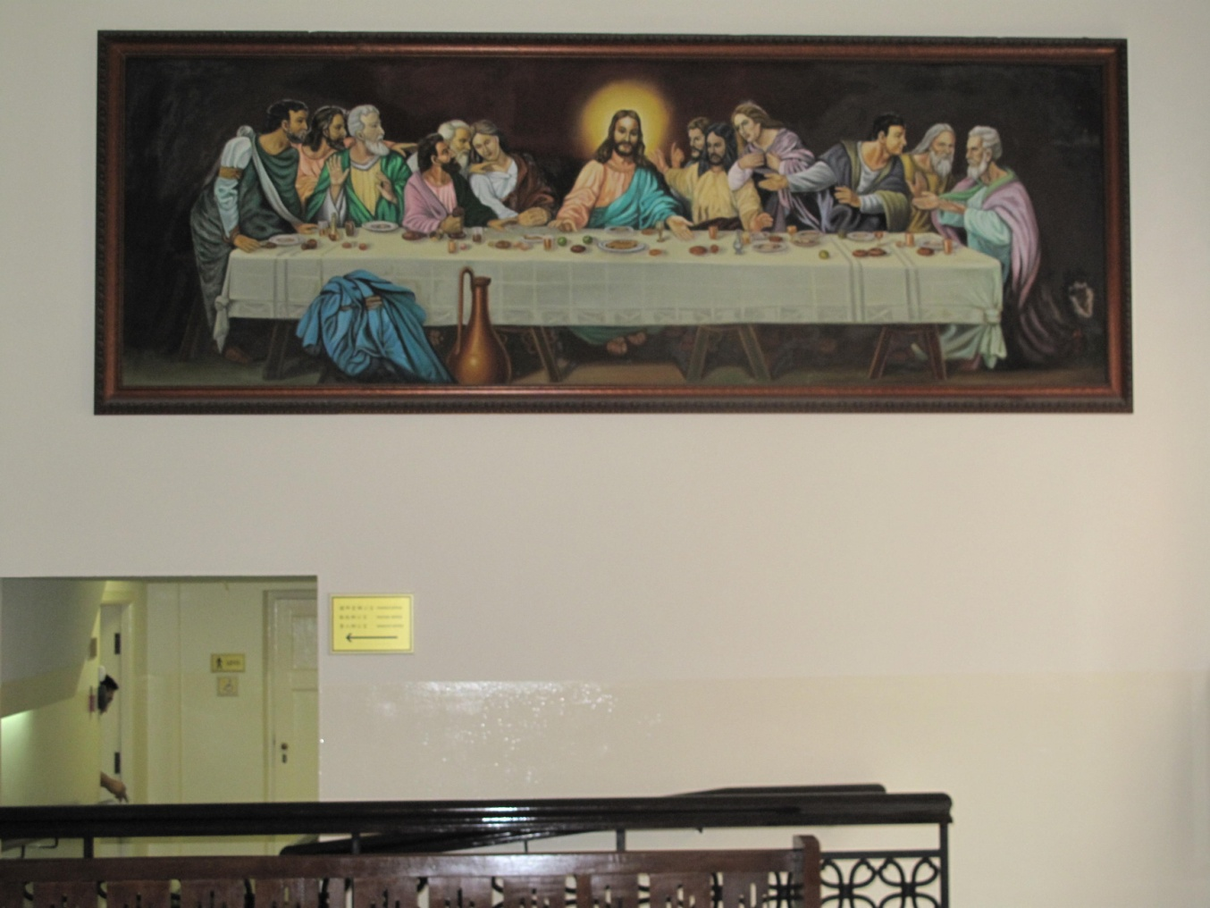
Former trapdoor at the bottom right section of this wall, which led to a small hideout that has since been covered
Notes:
Moving into the Social Hall, you can see a painting that follows Leonardo Da Vinci’s famous composition of the Lord’s Supper. This was painted by an elder of the church, Mr. Lim Yeow Tong; and was restored by his daughter. The picture aptly captures how Christianty brought the members of the Church into contact with significant aspects of Western culture such as Classical Sacred Music and Sacred Art. The other two paintings in the Social Hall were also painted by Mr. Lim Yeow Tong.
This wall hides another interesting feature – there used to be a trap door on the bottom right corner of the wall, which led to a small hideout just beneath the present day ladies’ room. British soldiers hid in this area when they were trying to escape from the occupying Japanese army in World War II. The trapdoor was later covered up as part of the Church’s restoration works.

Slide 7
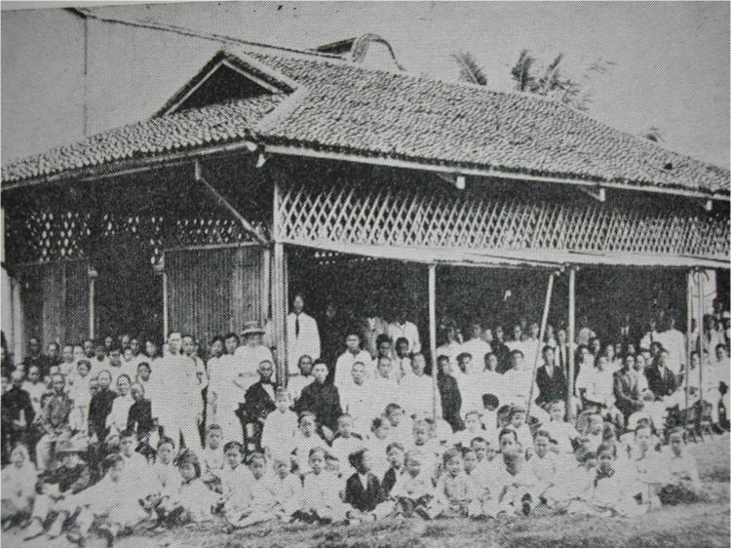
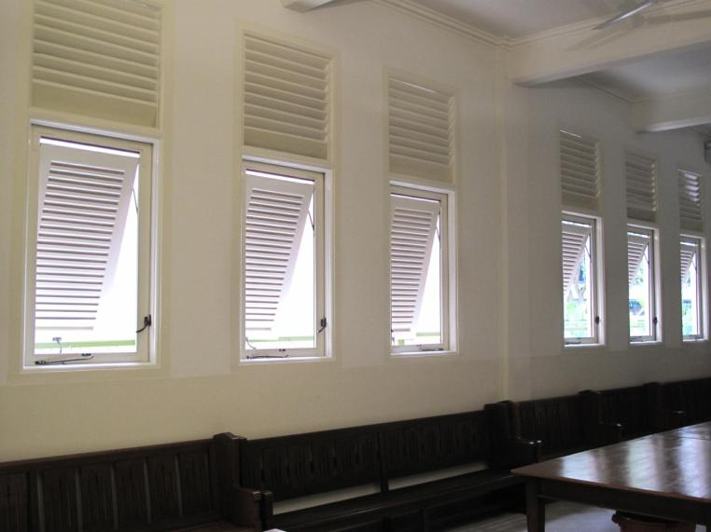
The old walls of the “Tin Hut Church” which had to be propped up to facilitate ventilation and movement
Windows along this wall can be pushed out, and propped up
Notes:
Just beside this wall, the row of windows are also an interesting architectural feature. Apart from being pushed outwards, they can also be propped up. This design recalls the old walls of the “Tin Hut Church”, which had to be propped up to allow for ventilation, and for people to enter and exit the building.
You may wish to note that there are a total of about 14 different window designs in the church building, each with its own meaning and significance. I will explain two more to you later on.

Slide 8
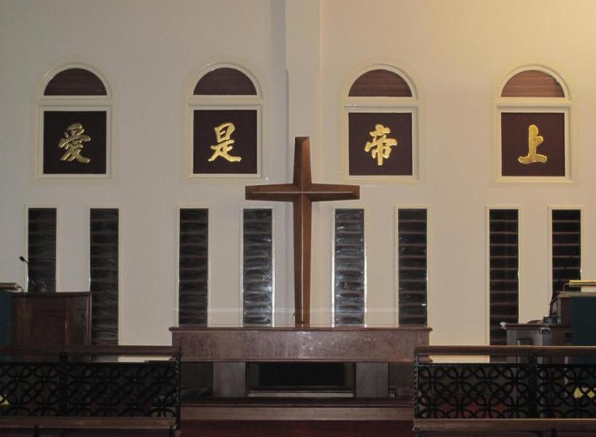
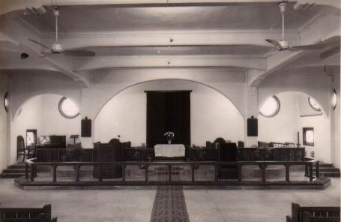
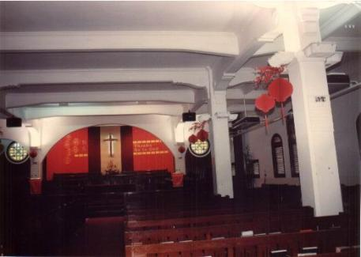
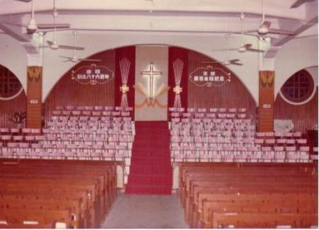
Church sanctuary, today
Church sanctuary, 1950s
Church sanctuary, 1970s
Church sanctuary, 1980s
Notes:
The next interesting feature of our Church is the Sanctuary, which is located on the 2nd floor of the building. While most sanctuaries are located on the ground floor of church buildings, it is believed that our Sanctuary was deliberately built on the 2nd level in order to minimise noise and disruptions to our worship services, especially from the hustle-and-bustle of the commercial activity in the area.
This slide shows photographs of our Sanctuary, from the 1950s to the present. Do you notice any striking difference?
[Desired Response: The four calligraphic Chinese characters above the altar cannot be seen in the old photographs.]

Slide 9
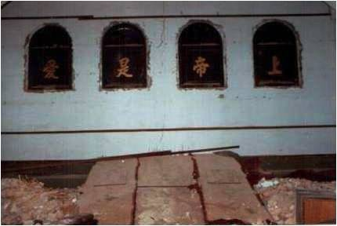
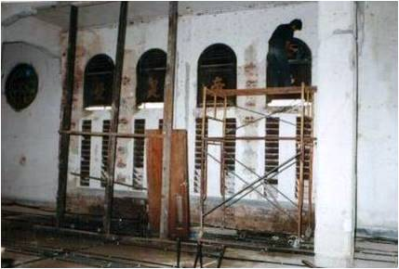
The four Chinese characters proclaiming the nature of God as Love originally featured in the Sanctuary, but were covered up and forgotten at some point in the Church’s history
During an extensive renovation project in the 1990s, the backdrop behind the pulpit was removed and the four Chinese characters were re-discovered – in a poor condition, but intact.
Notes:
Yes – the four calligraphic Chinese characters above the altar cannot be seen in the old photographs. They read “Shang Di Shi Ai” (上帝是愛), which proclaims the nature of God as that of Love (1 John 4:16). These characters featured originally in the Sanctuary; but it is believed that they were covered up as part of extensive renovation work in the 1950s and later forgotten. During the major preservation and conservation project in the 1990s after the church was chosen as a national monument, the four Chinese characters were found intact when the timber backdrop in the Sanctuary was removed, and they were fully restored and to the condition that you see today.

Slide 10
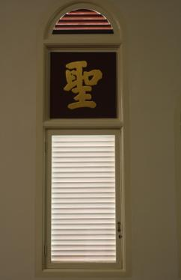
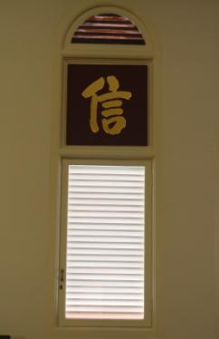
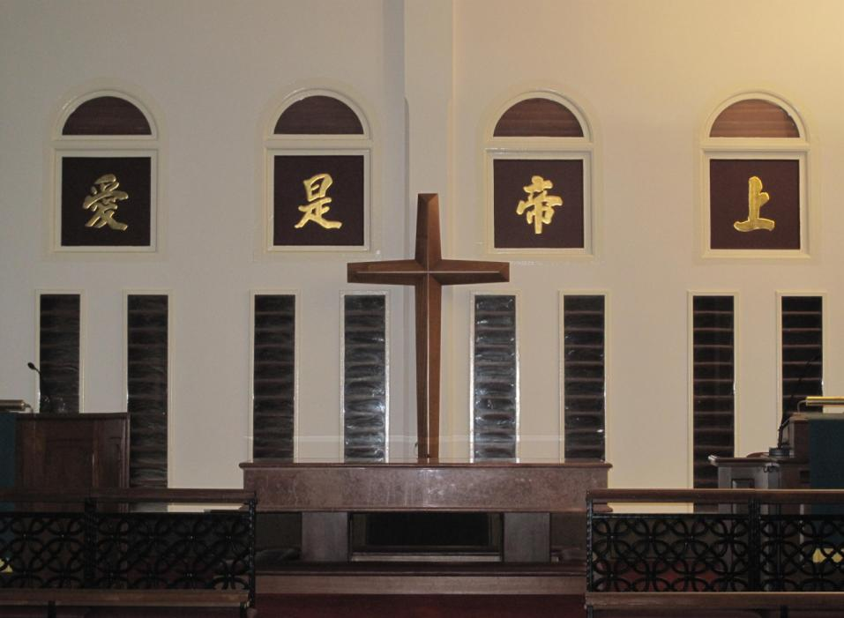
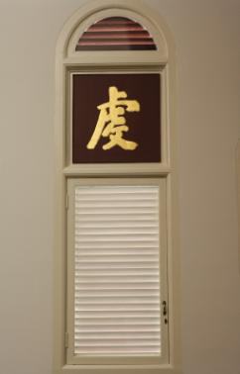
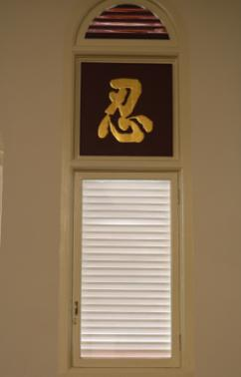
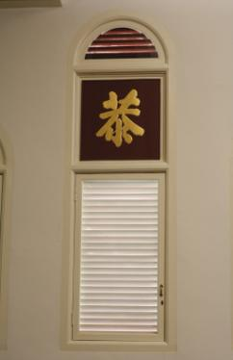
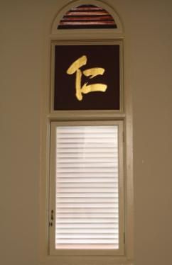
Notes:
There are also two other series of Chinese characters that surround the walls of the Sanctuary. These demonstrate how the gospel has been appropriated by the Chinese community in a distinctly Chinese way. Apart from the four characters on the front face of the Sanctuary, the other six characters on the left and right convey Chinese cultural virtues which are equally appropriate postures to adopt as one enters the presence of God to worship Him. They are accordingly: “Sheng” (聖 – Holiness), “Qian” (虔 – Devotion), “Gong” (恭 – Reverence); “Xin” (信 – Faith), “Ren(3)” (忍 – Patience) and “Ren(2)” (仁 – Love).

Slide 11
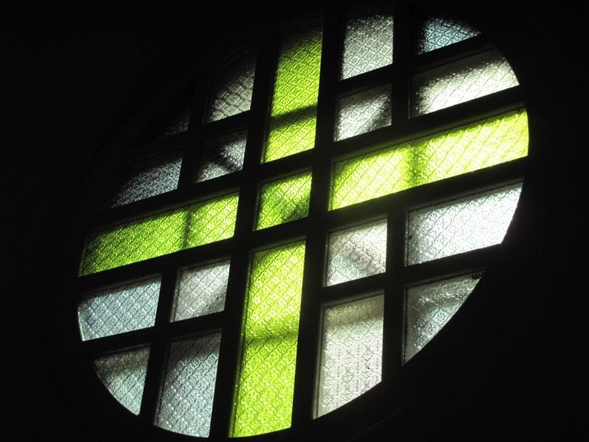
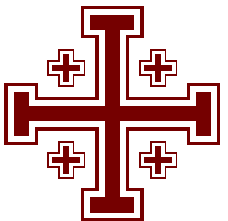
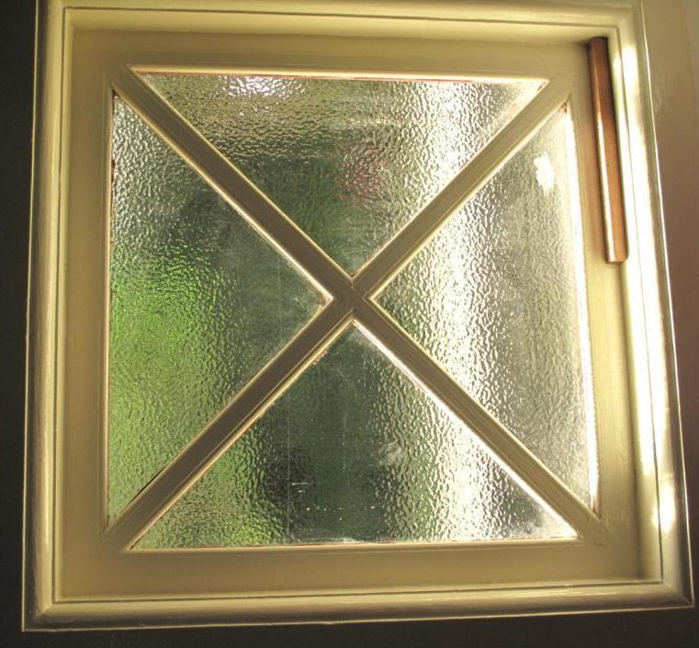
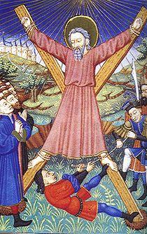
Jerusalem Cross, or Crusader’s Cross – so named because it was on the papal banner given to the Crusaders by Pope Urban II for the First Crusade
Apostle Andrew was believed to have been martyred by crucifixion on an X-shaped cross as he deemed himself to be unworthy to be crucified in the same manner as Jesus Christ.
Notes:
If you look beyond the pulpit area, you will also see two interesting window designs in the Sanctuary.
The circular window is arranged according to the Jerusalem Cross and features five crosses within. The four smaller crosses could be interpreted in several ways – the four books of the gospel, the four directions from which the gospel spread from Jerusalem, the four “Distinctive Emphasis of the Methodist Faith” (Conversion, Justification, Sanctification and Perfection) or the four elements of the Wesleyan Quadrilateral (Scripture, Reason, Experience and Tradition). All five crosses are sometimes also interpreted as the five wounds of Christ during the Passion, or the first five Christian churches.
The cross-shaped design in the square window could symbolise the gospel reaching the four corners of the Earth, or a conscious appropriation of the Cross of St. Andrew, which reflects the legend that the apostle Andrew was crucified on a tilted cross as he deemed himself unworthy to die in the same manner as the Lord.

Slide 12
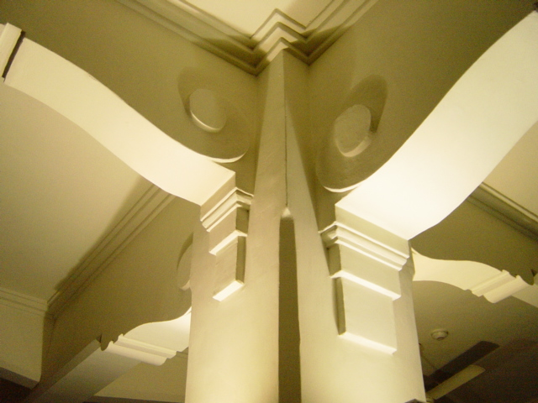
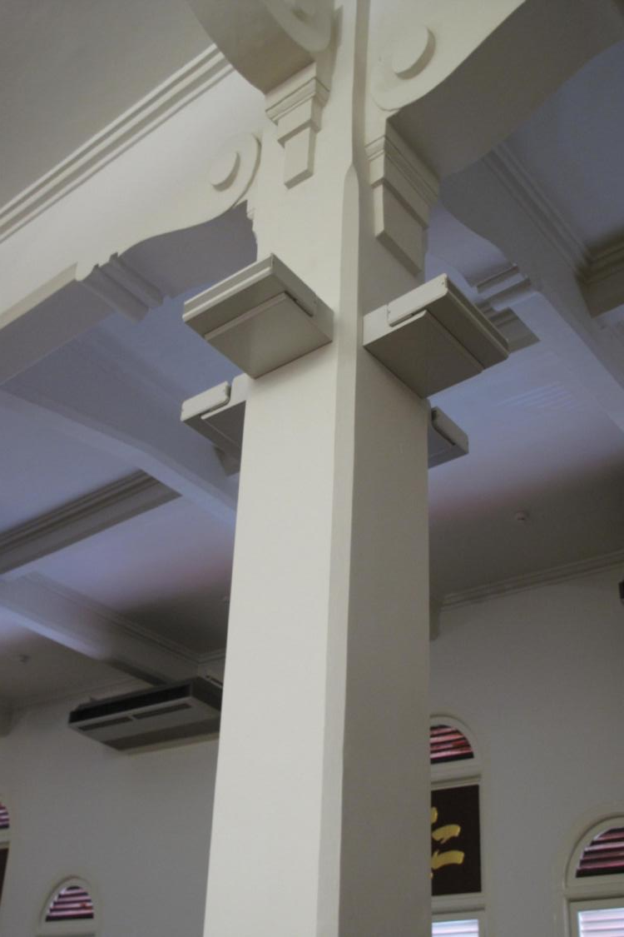
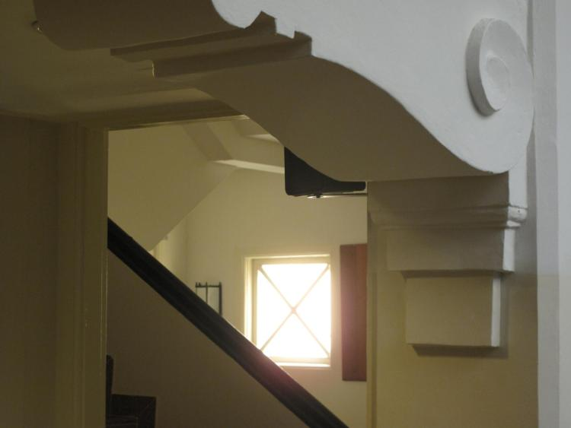
Scrollwork designs throughout the church building – Sanctuary, Social Hall, stairway, etc.
Notes:
There are also beautiful scrollwork designs on the columns and beams of the ceiling throughout the church building, including in the Sanctuary. Such scrollwork designs may be traced back to as early as the Bronze Age. It is most commonly associated, however, with Baroque architecture and was revived in the Art Deco period; the period in which this Church was built.

Slide 13
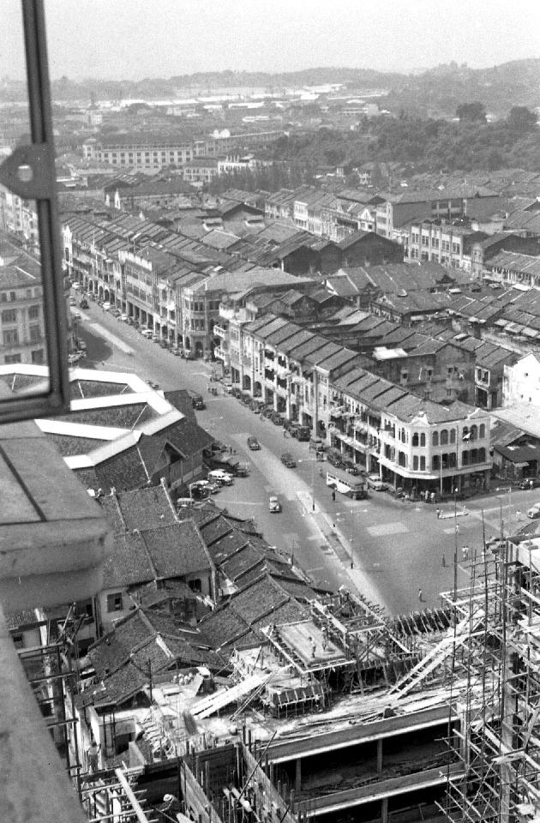
View from Asia Building, 1956
Notes:
Moving on to the fourth and highest level of the church building, the roof terrace was previously used as an observation post by the British as TACMC was the tallest building in the area for a long time after it was built, amidst the two- and three-storey shop-houses. You can spot the church building in this 1956 photography taken from Asia Building.

Slide 14
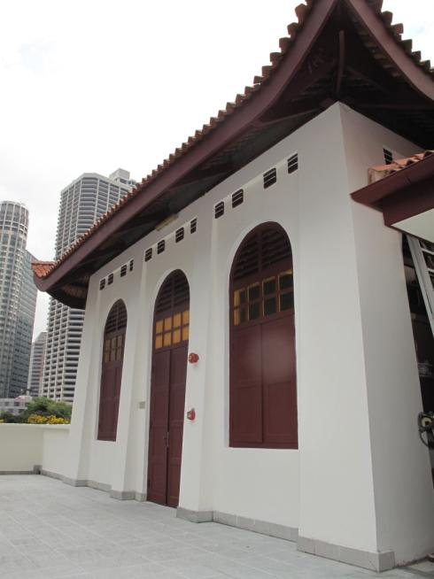
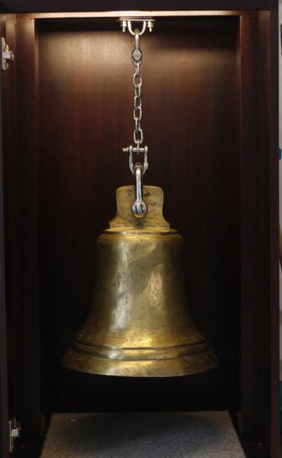
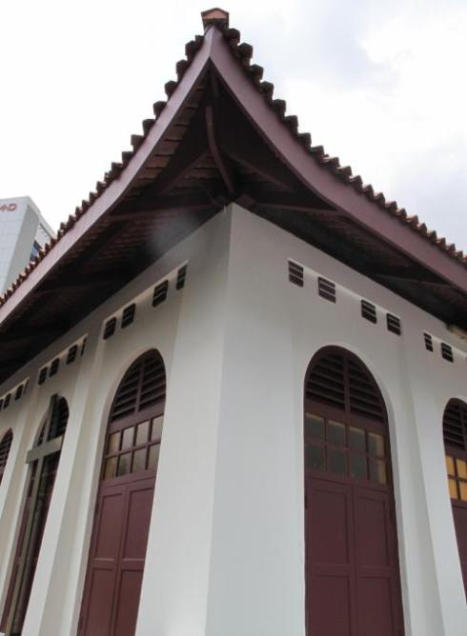
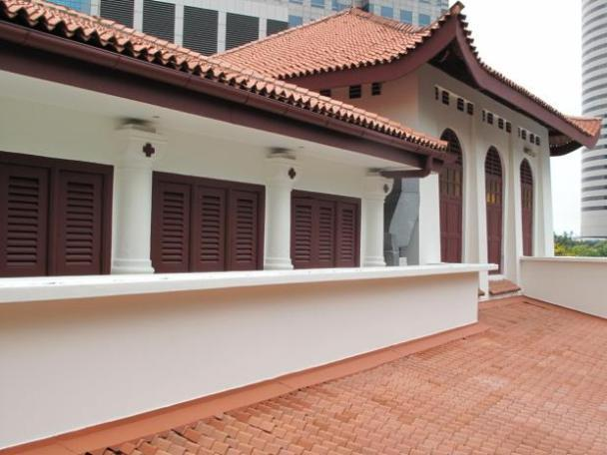
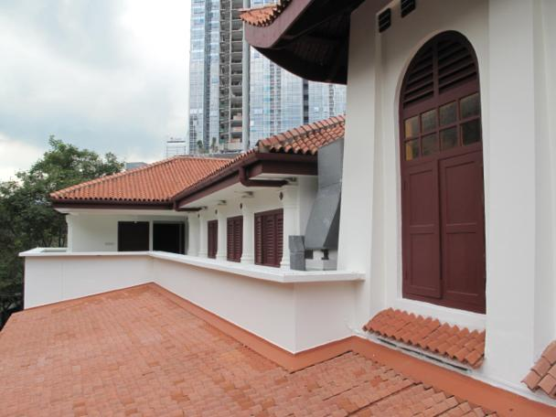
Notes:
The most distinctive feature of the church building is the rooftop pavilion with the upturned eaves of a traditional Chinese roof. This was not an uncommon feature in Chinese buildings of the same era. However, these were almost never used as “bell-towers”. Moreover, it was more common to find a bell-tower or a steeple on the roof of a church rather than a pavilion. In the case of TACMC, these two cultures found a meeting point as the Chinese roof pavilion was used as a bell-tower for the Church.
Although it is no longer used today, the bell was believed to have been rung to call worshippers to gather for service at the church. Before the advent of mass communications, this was important as it informed the public – especially the illiterate coolies in Telok Ayer – that there would be a gathering in TACMC. A decision was finally made to retire the bell as it was too heavy to support structurally and safely; and it now stands preserved in the Social Hall as a reminder of the Church’s outreach in the area.
There is also a prayer room on the fourth floor, and you may wish to take a peek inside. There, you will see a replica of the pulpit from which Dr. John Sung spoke when he came to Singapore.

Slide 15
The End
Notes:
I would now like to invite all of you to walk around the church premises, to see these interesting features for yourselves. More information can be found in the brochures that you collected when you came into the Church; and please feel free to approach any of our guides if you have any queries. Do gather back at the Social Hall at ________, in time for your bus to bring you to your next destination.
Thank you!

