Slide 1
Telok Ayer Chinese Methodist Church From Tin Hut to National Monument
Notes:
Good afternoon and welcome to Telok Ayer Chinese Methodist Church, or TACMC in short. This building is 95 years old, although the history of her people stretches back for 130 years. I will now give you a brief overview of this history so that you can better appreciate the role our church has played in the surrounding community, as well as the features around our church building, which is gazetted as a national monument.

Slide 2
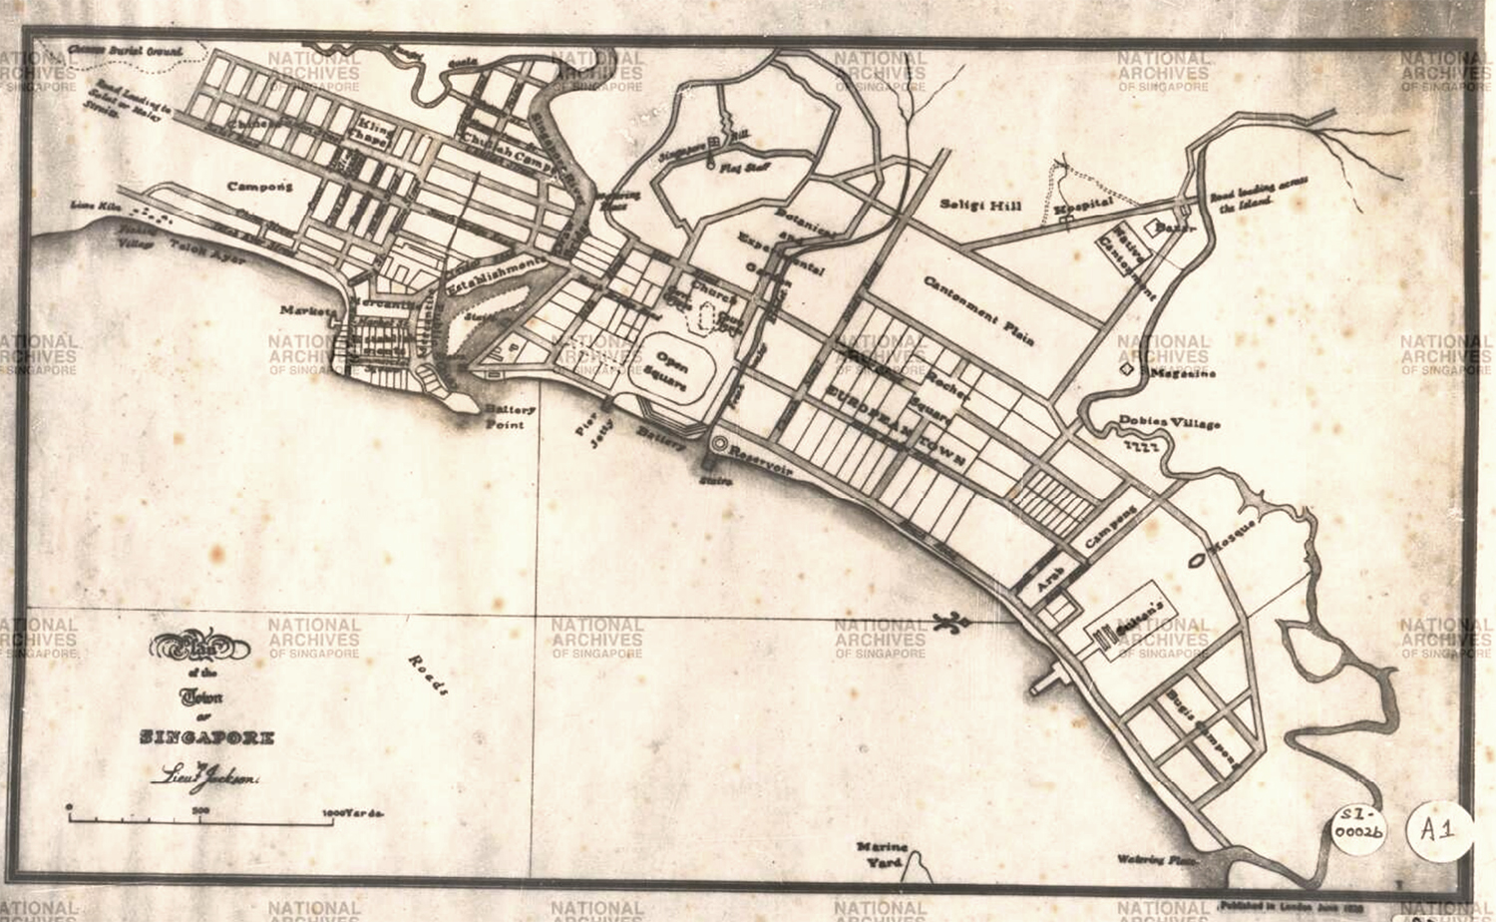
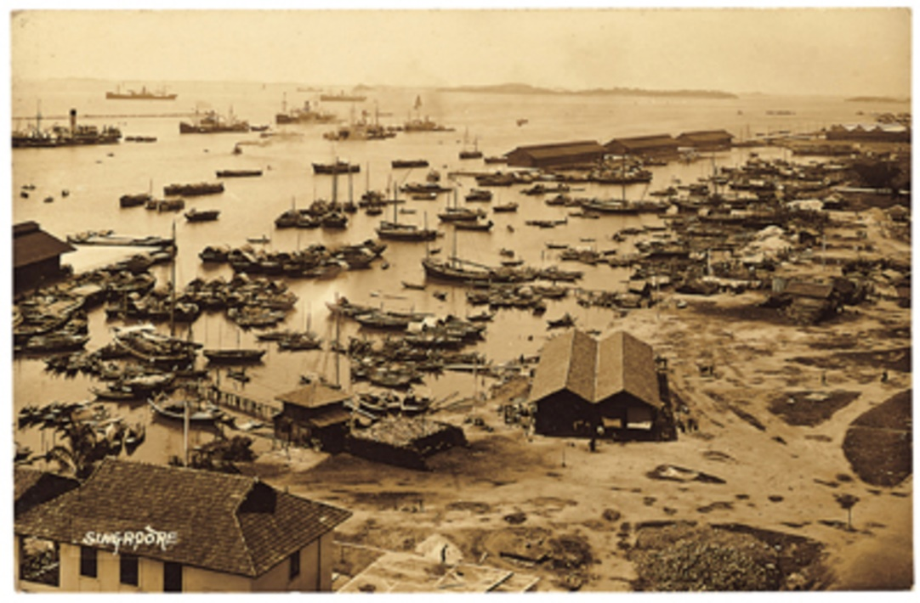
Telok Ayer
Jackson Plan, 1822
“Water Bay” or Telok Ayer Bay, 1900
Notes:
The phrase “Telok Ayer” is a Malay phrase. “Telok” means “Bay”, and “Ayer” means “Water”. As you can see from this 1822 Town Plan drawn up by Lieutenant Phillip Jackson, “Telok Ayer Street” was originally a street running along the early Water Bay of Singapore located beside the mouth of the Singapore River. This was where the early immigrants to Singapore first landed. In this area, you will find the earliest Chinese and Indian temples in Singapore, as one of the first things that the early immigrants did was to build these places of worship to thank their gods for a safe passage across the seas.

Slide 3
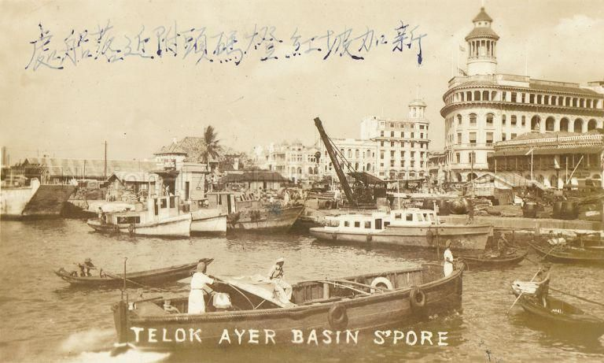
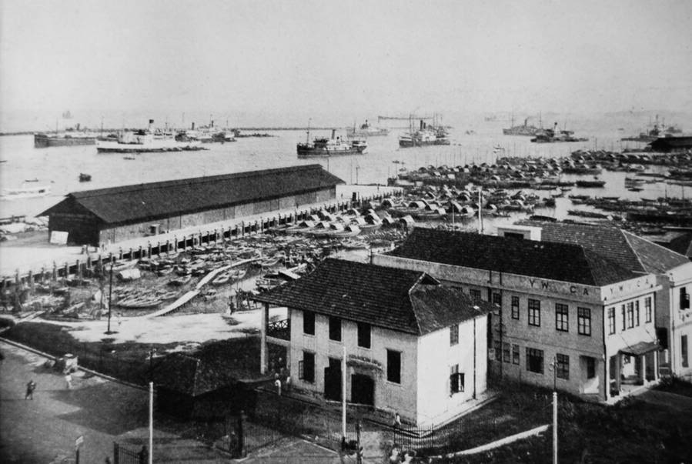
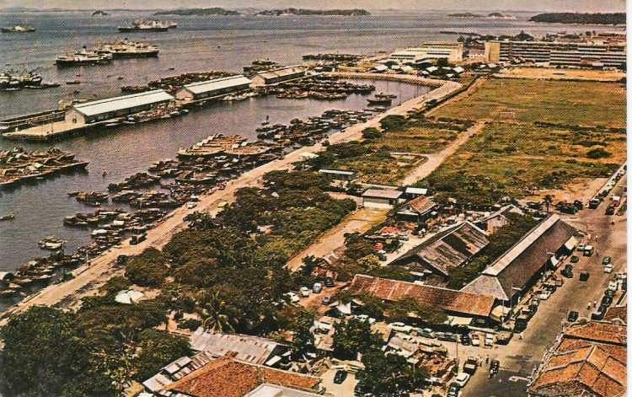
Telok Ayer Basin 1935
Telok Ayer Basin 1940
Telok Ayer Basin 1960
Notes:
At that time, Shenton Way did not yet exist, and what is now Robinson Road and Cecil Street was just plain sea. An early land reclamation in 1887 created the land on which Cecil Street and Robinson Road now stands. A later land reclamation in the early 1900s created the extra space that is now taken up by Shenton Way. All these developments pushed the land on which our church is located, four streets further away from the seafront where the early immigrants to Singapore first landed.

Slide 4
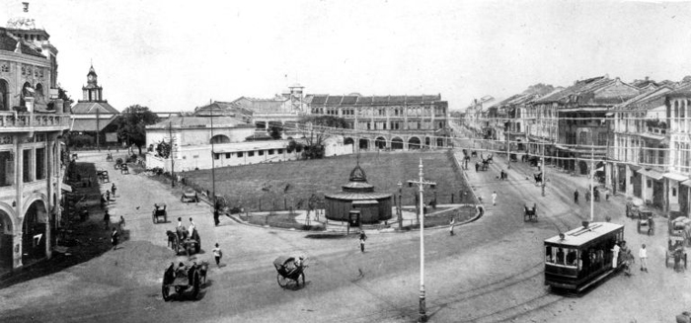
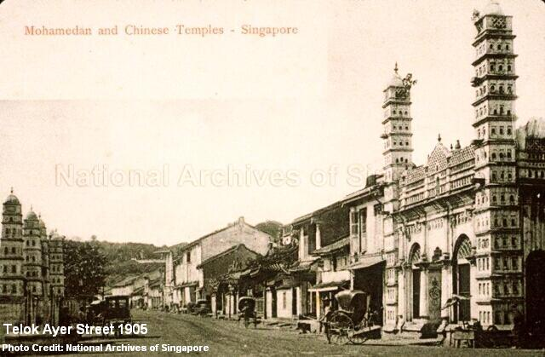
Clock tower of Lau Pa Sat
Cecil Street 1900
Telok Ayer Street 1905
Notes:
In the early 1900s, Cecil Street looked like this. If you look carefully at the top left hand corner of the picture, you will be able to spot the clock tower of Lau Pa Sat. You can still see that today when you stand at the junction of Cecil Street and Telok Ayer Street just outside our church. Telok Ayer Street looked like that in 1905. Along this street, you will find the earliest Chinese and Indian temples in Singapore, as one of the first things that the early immigrants did was to build these places of worship to thank their gods for a safe passage across the seas.

Slide 5
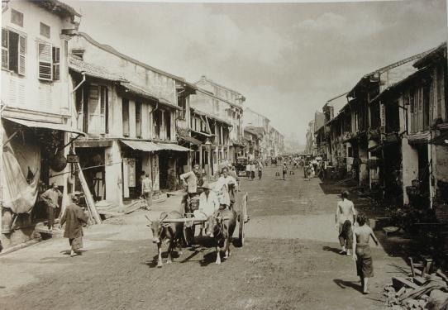
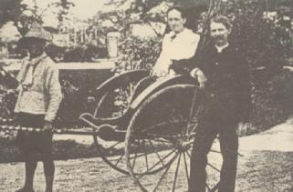
Cecil Street, 1900
Early Hokkien immigrants
Telok Ayer Street, 1905
Dr Benjamin West
Notes:
It was out of this context that our Church was born. In 1889, an American missionary, Dr. Benjamin West, started a medical clinic in a shop-house at Upper Nanking Street (no longer in existence), where he reached out to the early Chinese immigrants (largely the Hokkiens) while practicing medicine. This was in fact the first medical clinic in Singapore offering Western medical services. God blessed this work and by the mid-1890s, the congregation had expanded from 30 members to 170 and was made up of Chinese immigrants across various dialect groups.

Slide 6
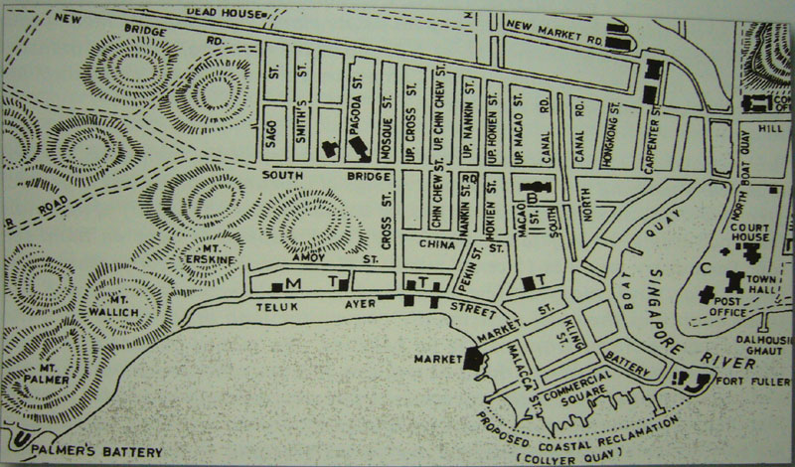
1
Upper Nanking St.
2
Japan St. (Boon Tat St.)
3
Telok Ayer St.
Map of Telok Ayer, 1862
Notes:
The Church grew fast, and a larger and more permanent place of worship was needed. In 1913, the land at the junction of Telok Ayer Street and Cecil Street, where Gan Eng Seng School first began, and where the church now stands, was purchased for $3,600.

Slide 7
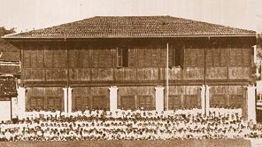
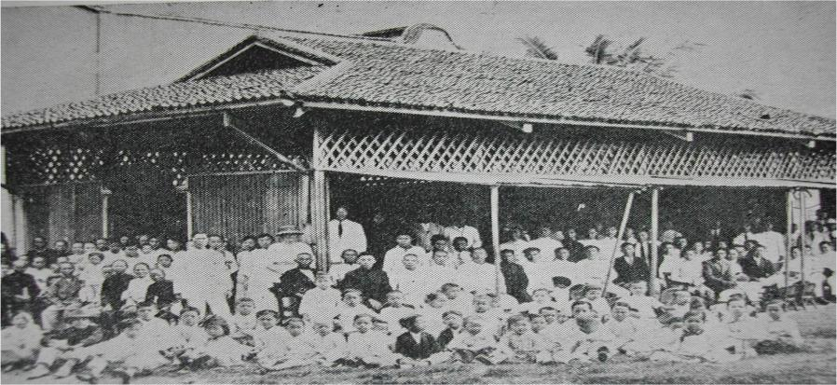
The walls of the Tin Hut Church had to be propped upwards to facilitate ventilation, and for people to enter/exit. You will see this commemorated in one of the window designs in our present church building!
Gan Eng Seng School, on the present TACMC site
Tin Hut Church
Notes:
Worship was held in tents on the vacant lot until these collapsed in 1914. A “Tin Hut Church” made out of wood and corrugated iron was completed in September 1915. As can be seen from the picture, the sides of this Tin Hut Church had to be propped up for ventilation, and to allow for people to enter and exit the building. This was our first formal church building. It was only in 1918 that plans for a more permanent structure were undertaken.

Slide 8
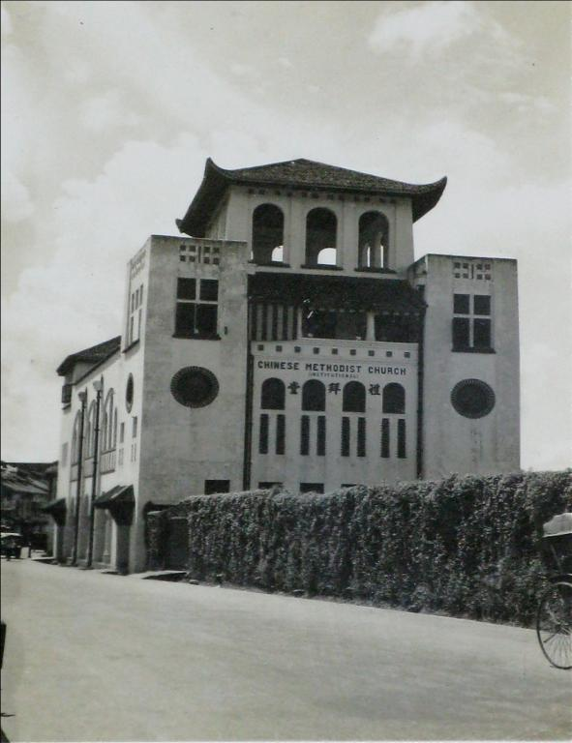
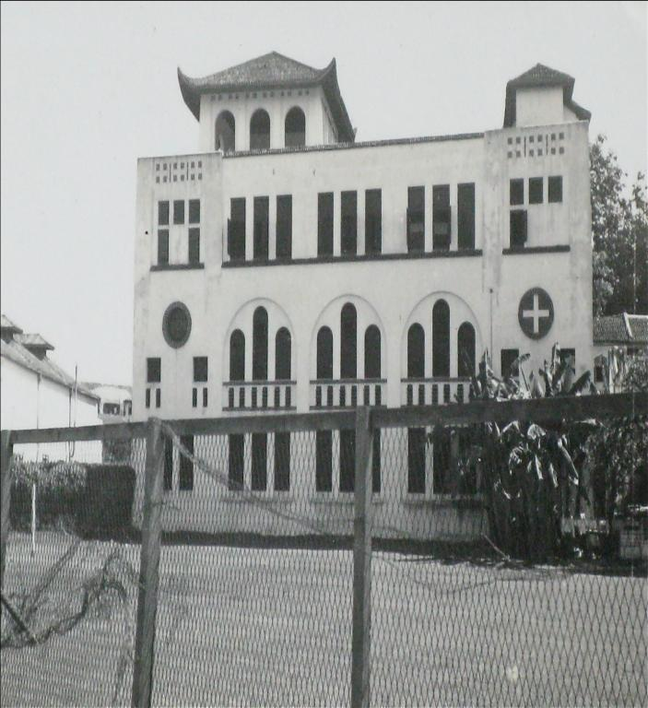
Early Building of Telok Ayer Chinese Methodist Church
Looks the same as today?
Notes:
The church building as we see today was completed in 1924, and dedicated in 1925. Swan & Maclaren the oldest architectural firm in Singapore, was responsible for the project. The firm was also responsible for iconic buildings as the Victoria Concert Hall, Raffles Hotel, Goodwood Park Hotel and St Andrew’s Cathedral. In 1989, one hundred years after the founding of the church, the church building was gazetted by the Government as a National Monument of Singapore. In 1989, one hundred years after the founding of the church, TA’s church building was gazetted by the government as a National Monument of Singapore.

Slide 9
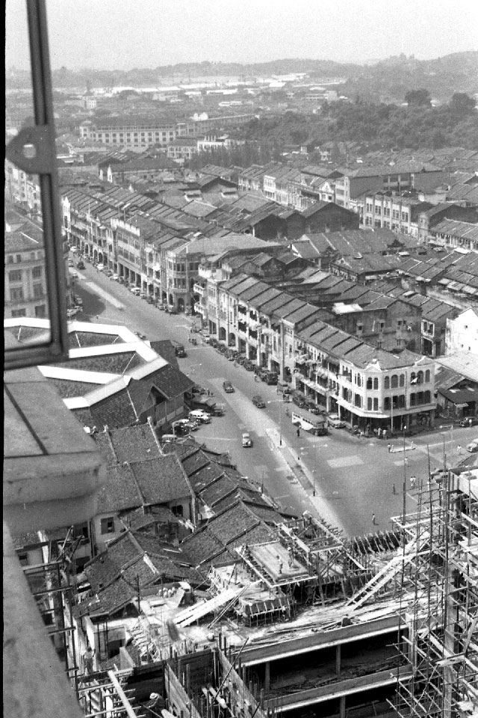
Robinson Road 1956: View from Asia Building
Notes:
For a long while after the church building was completed, it was the largest and strongest building in the area. This photograph taken in 1956 shows that it was still even then, the tallest building in its vicinity.

Slide 10
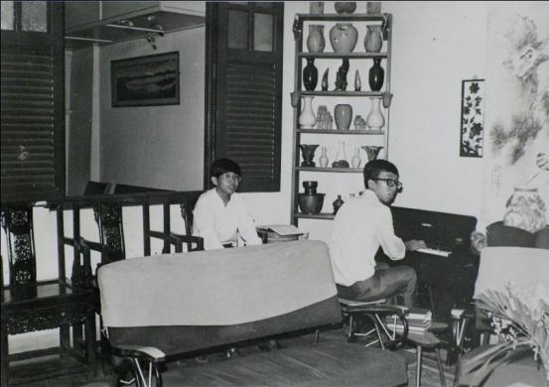
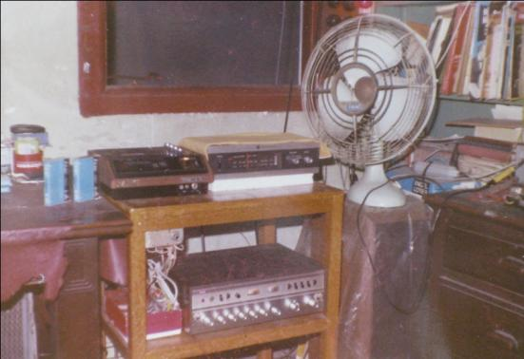
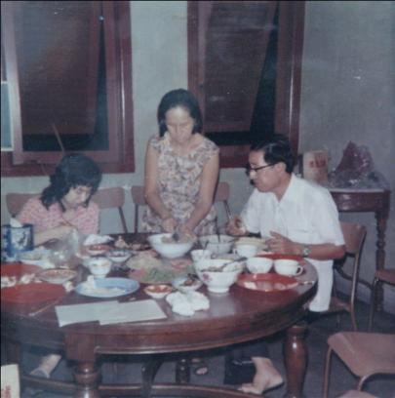
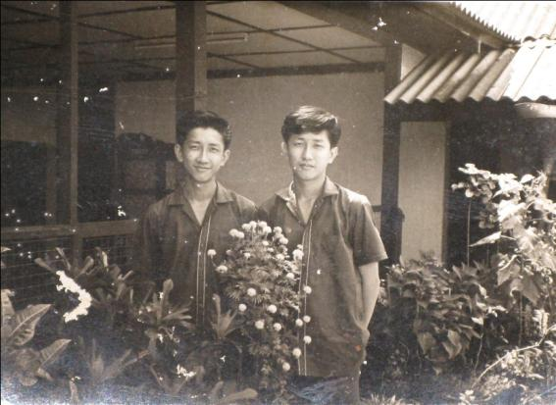
3rd Level Living Room
3rd Level Living Quarters
3rd Level Dining Room
4th Level Roof Garden
Notes:
The church and its building played an important role in the lives of the early Chinese immigrants to Singapore. Besides the weekly worship held in the church twice every Sunday, the church was also a place of meeting, learning and fellowship for the Chinese immigrants. Here, they came into contact with Christian Sacred and Classical Music of the West and were also introduced to Western Sacred Art. For the illiterate, help could also be found for writing letters back to family and relatives in China. The third and fourth levels of the church also served as a parsonage and living quarters for some of the Chinese immigrants. Many of our church members today are the descendants of these early Chinese immigrants. The pictures show how the third and fourth levels of the building looked like back then.

Slide 11
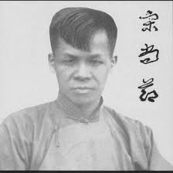
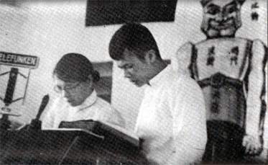
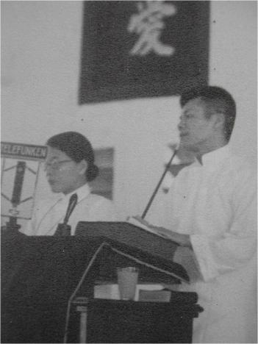
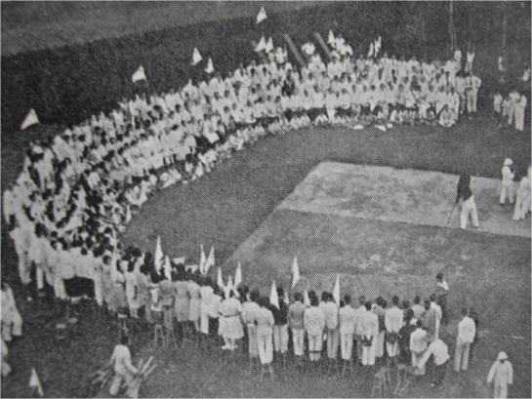
Dr John Sung
Remember this pulpit; it can still be found in our church building today!
Preaching at TACMC
Evangelistic Rally
Notes:
Telok Ayer Methodist was also one of the bases out of which the Evangelist Dr John Sung functioned in the 1930s here in Singapore. Dr. John Sung was a powerful evangelist used by God to convert thousands in China and South East Asia in the 1930s. When he was in Singapore, he used the living quarters in the church as a base of operations, and the pictures shows a scene from one of his evangelistic rallies. As a result of Dr John Sung’s ministry, many of the opium houses and gambling dens along Amoy Street had to close for business, as the people were flocking to hear the gospel instead of going to gamble and smoke opium. The last picture shows him preaching in our church. The pulpit in the picture can still be found in our church today, at the Prayer Room on the 4th Floor.

Slide 12
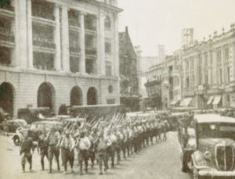
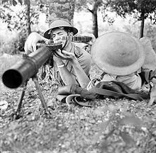
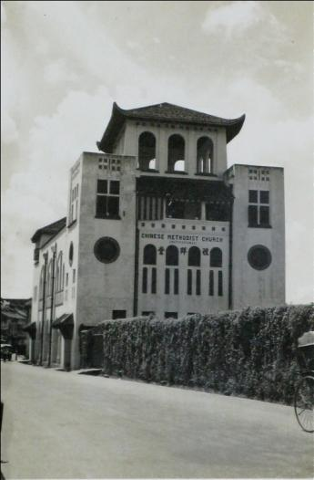
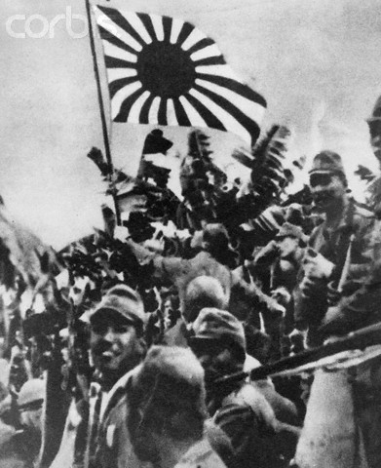
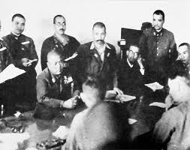
Japanese Invasion of Malaya
Singapore Volunteer Force
British Surrender of
Singapore
Battle of Singapore
Notes:
Our Church was also a place of refuge during World War II. It was used as a medical post and a bomb shelter. Whenever the bomb sirens sounded, people would quickly run to find refuge in the church building. Around 300 people in the vicinity sought refuge in the church. The Church also provided British soldiers with a place to hide when they were being hunted down by the Japanese army.

Slide 13
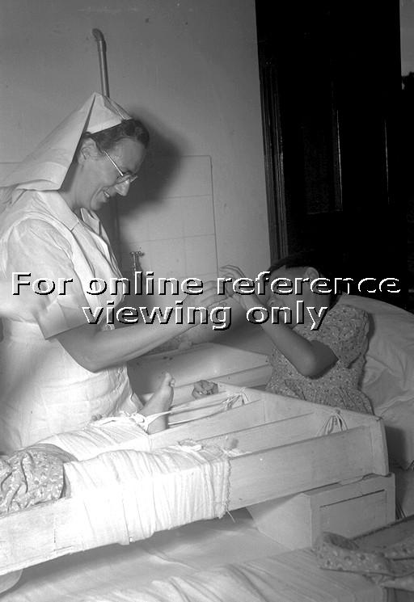
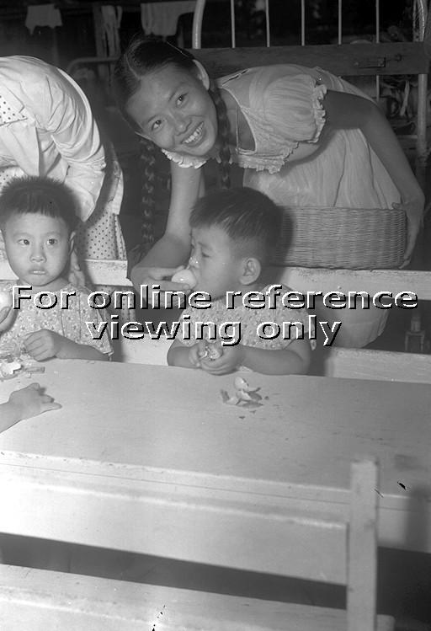
Community Outreach:
Members of Telok Ayer Methodist Youth Fellowship Distributing Easter Eggs at St Andrews Orthopedic Hospital in Siglap
Notes:
After the war, the church continued to be actively engaged, not only in the spread of the gospel, but also in caring for the social needs of the people around her. These pictures from a Straits Times report show some members of the Telok Ayer Methodist Youth Fellowship distributing Easter Eggs to the patients at St Andrews Orthopedic Hospital in Siglap. Members and ministers of Telok Ayer Methodist were also instrumental in helping to set up such agencies as the Prisons Fellowship of Singapore, Care Corner Ministries and the Chen Su Lan Home.

Slide 14
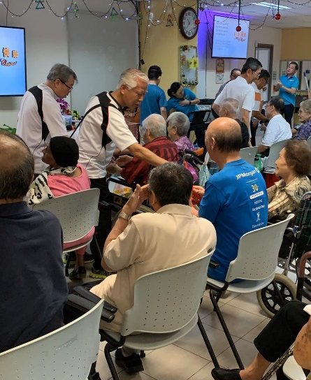
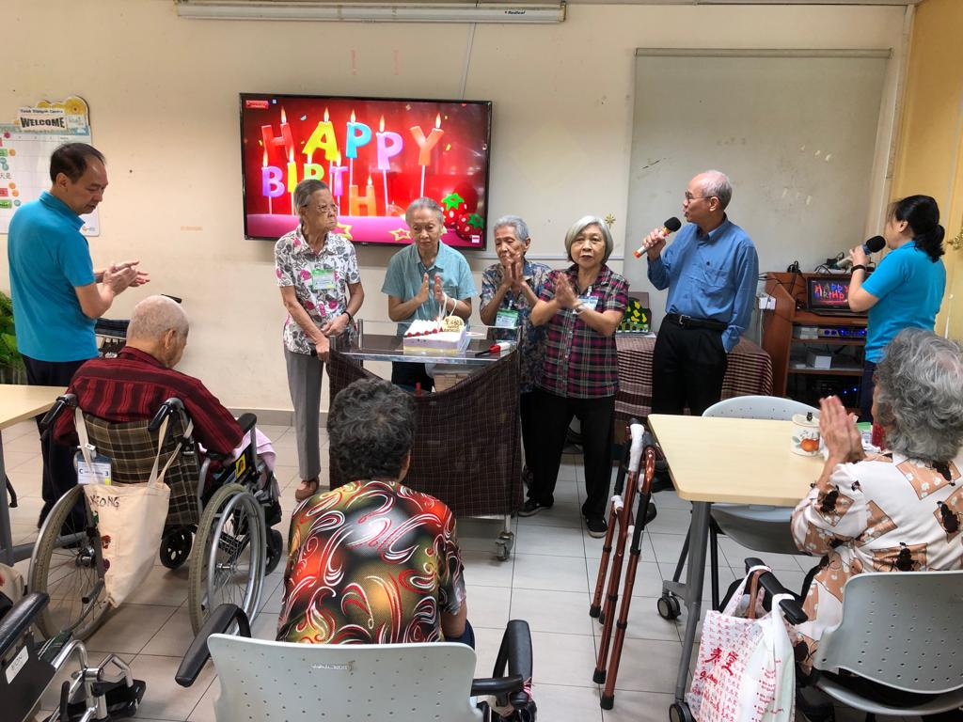
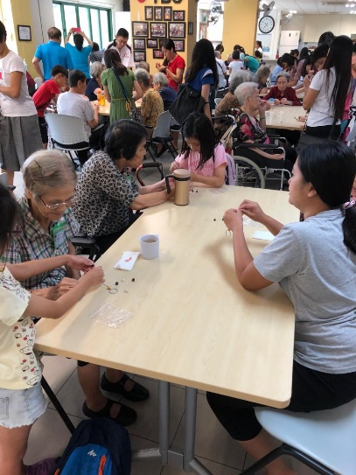
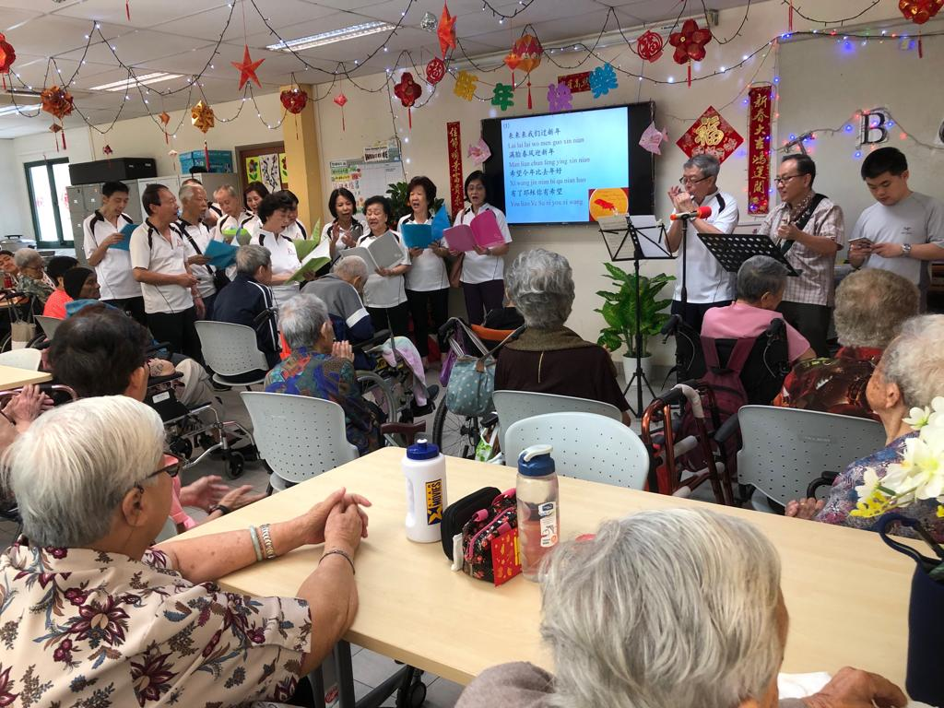
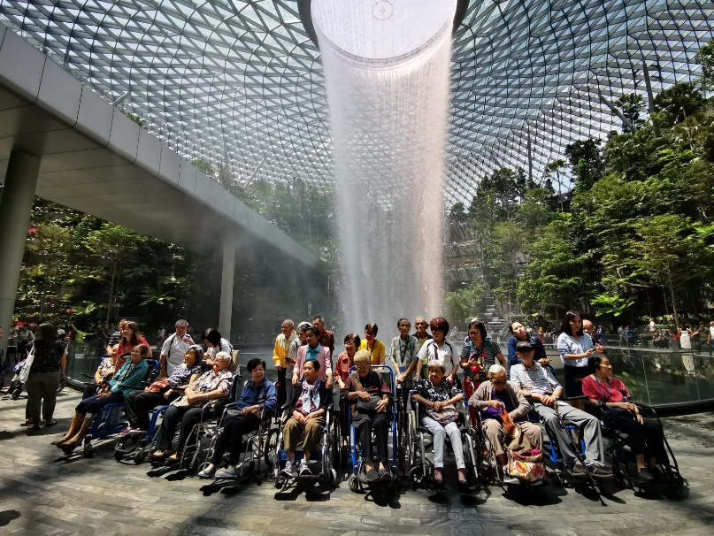
Community Outreach:
Serving the Elderly of St. Luke’s ElderCare at Telok Blangah
Notes:
Till today, our church continues to be actively involved in serving the surrounding community. Here are pictures of our members serving the elderly members of St Luke’s ElderCare at their Telok Blangah Centre and bringing them on an outing to Jewel Changi Airport.

Slide 15
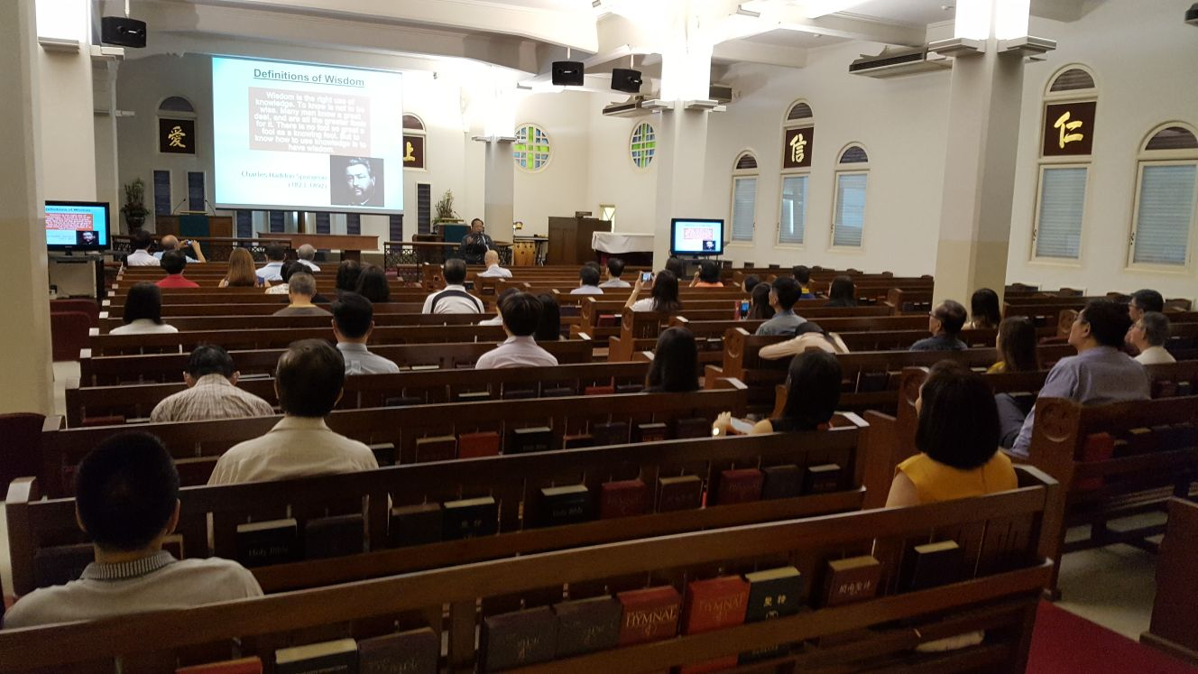
Community Outreach: Wednesday Lunchtime Service
Notes:
To serve the needs of the CBD workers around us, we hold a service every Wednesday lunchtime to allow working people to take a pause during their busy workday. We also provide free lunch to all attendees after the service.

Slide 16
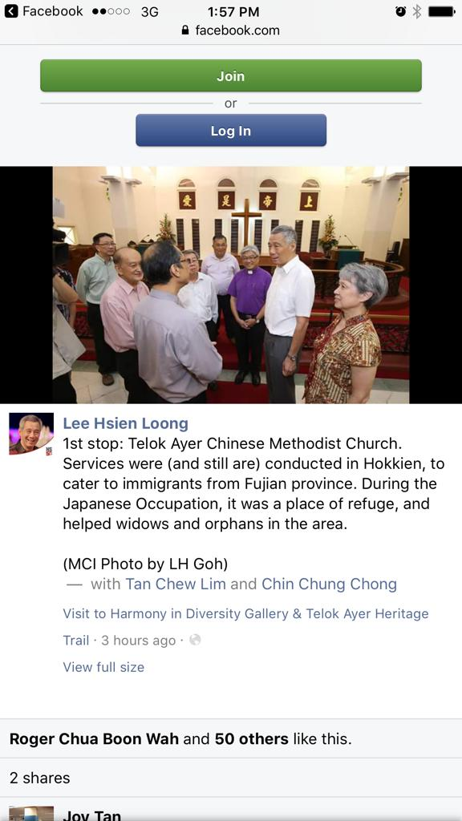
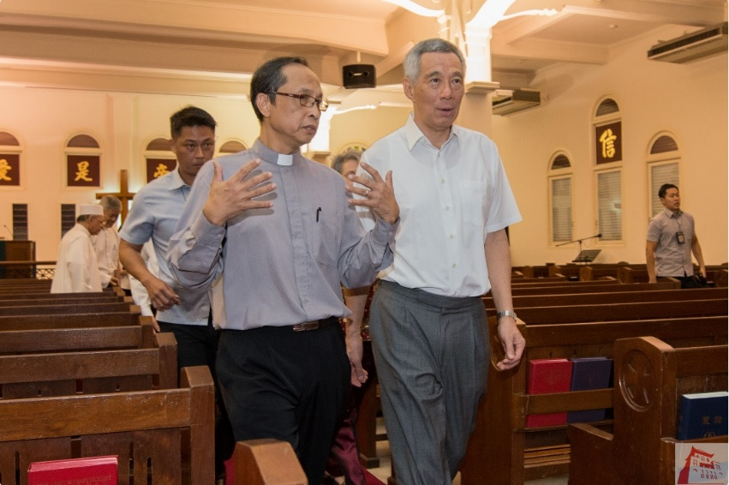
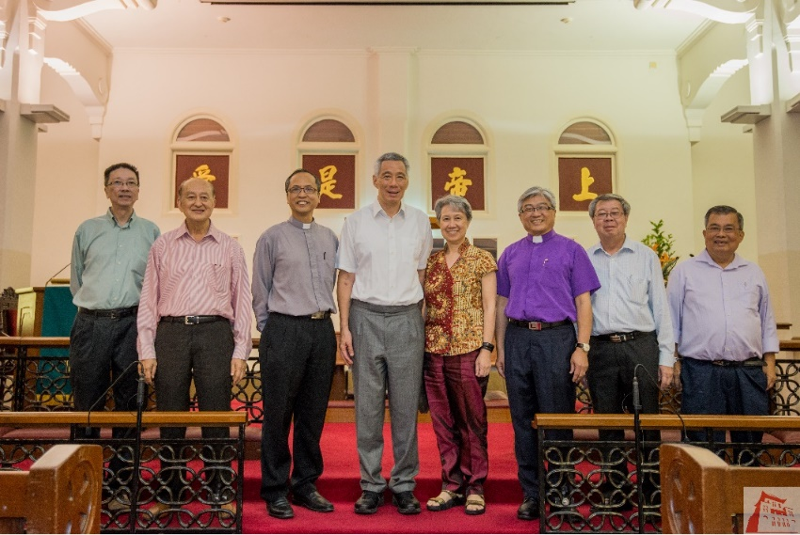
Hosting Visits: PM Lee Hsien Loong and Mdm Ho Ching
Notes:
As a national monument and a pro-active member of the community, our church plays our part to promote inter-religious harmony by regularly hosting visits to our premises. Here are pictures from a visit by Prime Minister Lee Hsien Loong and his wife Madam Ho Ching on 20th July 2017, on the eve of Racial Harmony Day, when he visited places of worship along Telok Ayer Street.

Slide 17
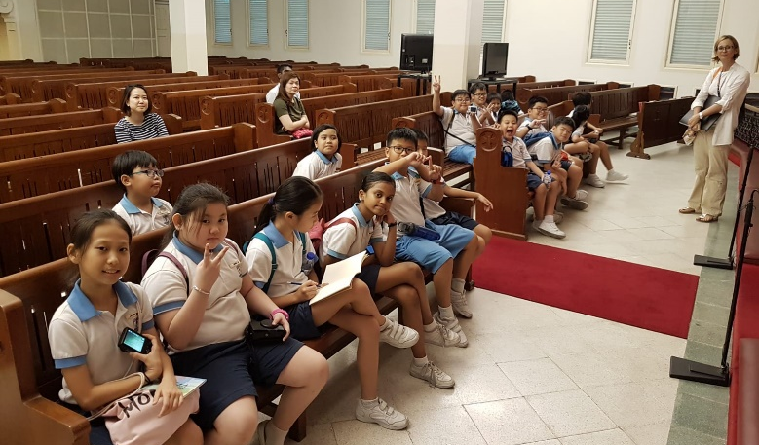
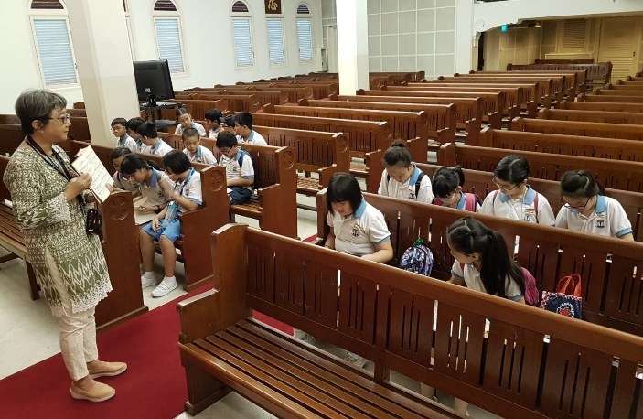
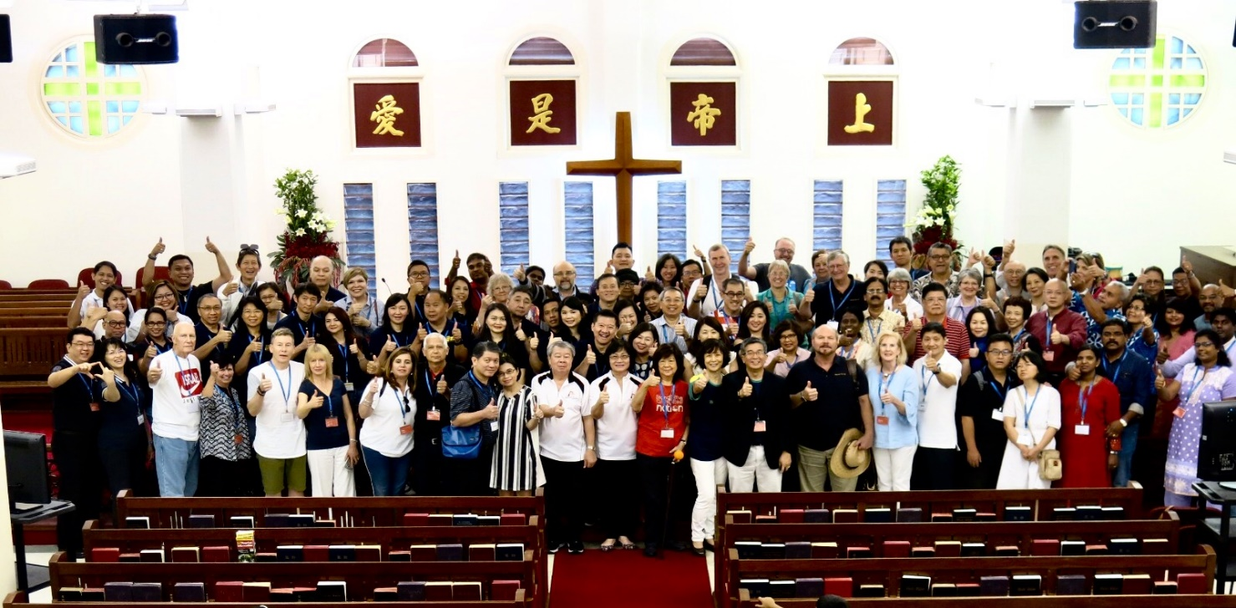
School Visits
International Organisation - 2equal1
Hosting Visits from Various Organisations
Notes:
We also regularly host visits from schools and various organisations. These are opportunities for us to promote better understanding of our multi-religious heritage in Singapore and show how Christian organisations like our church contribute to the wider community.

Slide 18
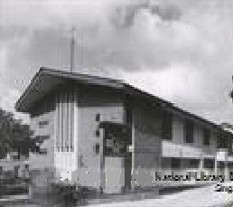
Telok Ayer Chinese Methodist Church From Tin Hut to National Monument
Notes:
Through God’s blessings, we have grown from a Tin Hut to a National Monument today. We currently have a membership of over 1,800 worshippers and are functioning out of two locations – this church building as well as Telok Ayer 2 along Telok Blangah Rd. We are conscious of the fact that God has blessed us abundantly for well over 130 years, and that we have been called to be a blessing to the people and community around us.
Thank you for coming to visit us today and we hope that you will have a meaningful time.

Slide 19
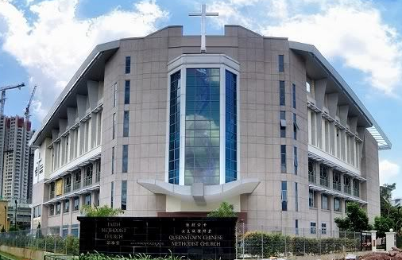
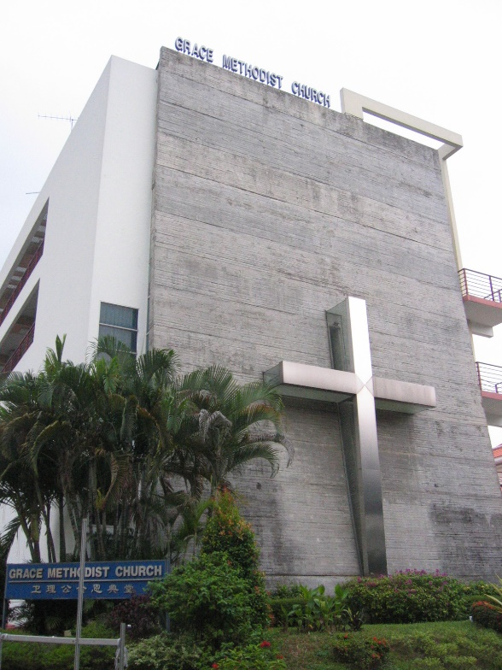
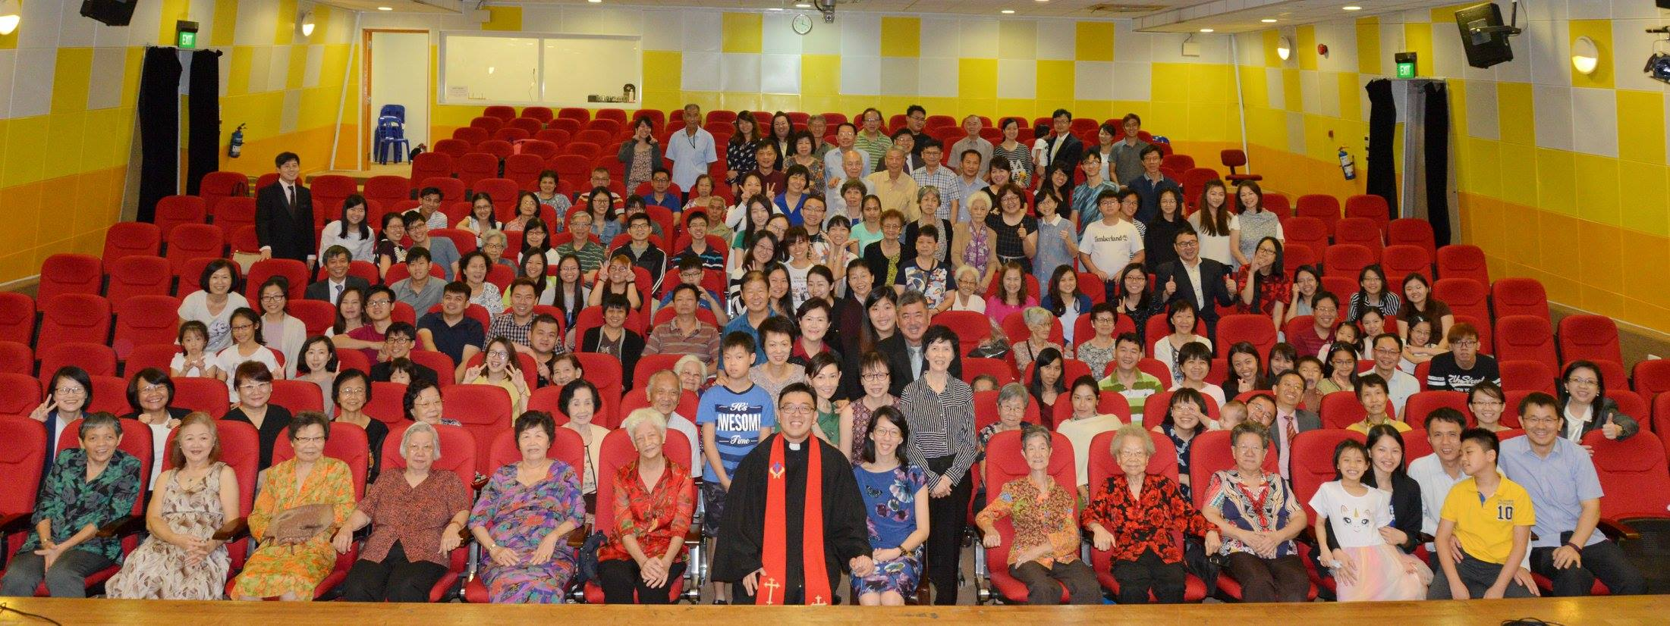
The Church expands…
Multi-Language Services:
Hokkien Service
English Service
Mandarin Service
Bahasa Indonesia Service
Queenstown Methodist Church
Grace Methodist Church
Holy Covenant Methodist Church
Notes:
Over the years, our members have helped to give birth to “daughter churches”: Grace Methodist Church, Queenstown Methodist Church, and Holy Covenant Methodist Church. From an original Hokkien service, we have also formed the English, Mandarin and Bahasa Indonesia Services

